Slide 1
Lesson 7: Job Preparation and Internship Support Motivation at Workplace
M3

Slide 2


Slide 3

Simple motivation tips to get more work done

Slide 4

“Just Five Minutes ”
It is enough to break through an hour has passes that you have done your work.

Slide 5
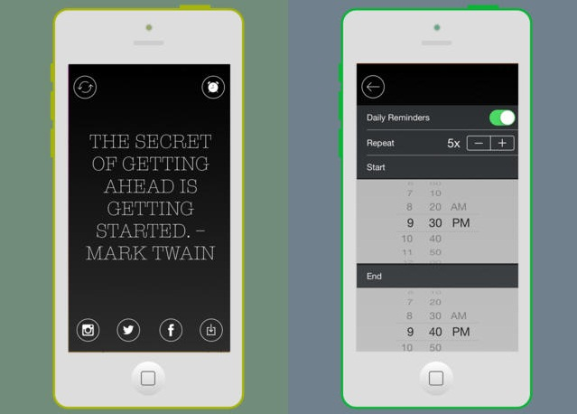
Tune into an inspirational playlist
Notes:
- Tell about the important of this app to students to awake everyone have power to work.

Slide 6
Use your body to trick your brain
Stop slouching & get moving ! Smile, laugh & walk around your office.
Adjust your physiology changes your brain & help your focus

Slide 7
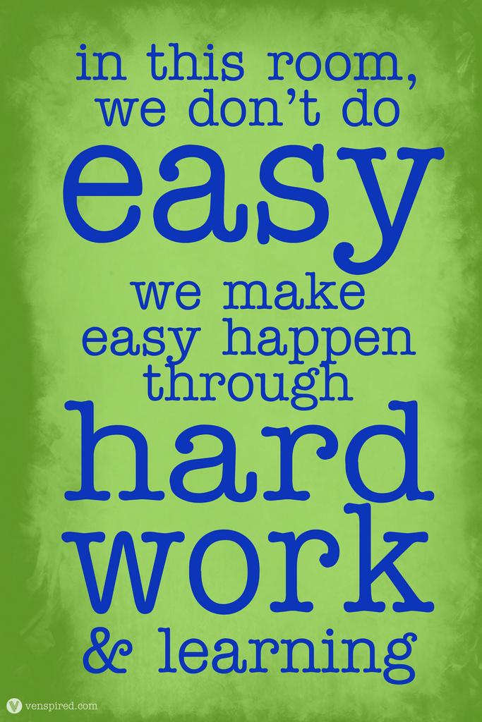
Don’t think about it as hard work
Notes:
“There is only one way for me to motivate myself to work hard: I don’t think about it as hard work. I think about it as part of making myself into who I want to be. Once I’ve made the choice to do something, I try not to think so much about how difficult or frustrating or impossible that might be; I just think about how good it must feel to be that, or how proud I might be to have done that. Make hard look easy.” Marie stain.

Slide 8
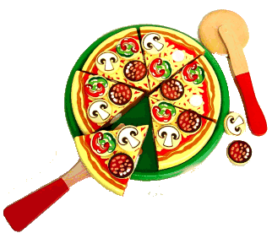
Create small, bite-sized goal
Rather than focusing on a large, scary goal, take one thing at a time, and break the big goal into ideas you can digest one at a time.
Notes:
I put the picture of pizza means as our work. If we get the project or big work, we need to divide it into pieces.

Slide 9

Read daily
Developing a daily reading habit is one thing that’s likely to have a long-lasting impact on your thought processes, ultimately inspiring you in all areas of your life.

Slide 10
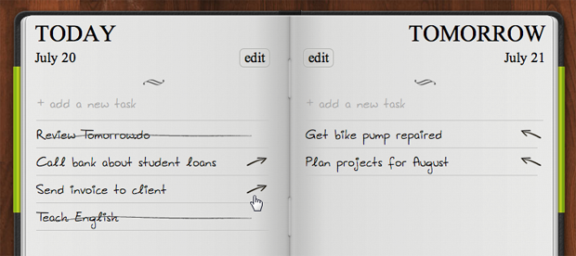
Plan tomorrow tonight
Create a short list of simple to dos tonight for running tomorrow.

Slide 11

Stop caring about the things that don’t matter
Look very carefully and closely at your list, and shave off anything that’s both truly demotivating and unnecessary for you to do.

Slide 12
Remind yourself of your goal
What are you working toward?
Set your desk background with a photo of your family, dream vocation, diploma with your name on it, and whatever it is you are working to achieve.

Slide 13

Help others
Sharing your talents not only benefits other, it shows you what capable of. Feeling confident & seeing impact you can make are powerful motivator.

Slide 14

Celebrate Win
Treat yourself with small things and don’t underestimate how gratifying it can feel to recognize tiny advancements.

Slide 15

Discussion
Take a moment
If you could name one thing that would most inspire your motivation to perform well in the workplace, what would it be? Money? Any thing else?
-----------------------------------------------------------------------------------------------------------------------------------------------------------------------------------------------------------------------

Slide 16
Discussion
Take a moment
Why do you think you work? Is survival the only reason, or do you work for something more? List some of the reasons you work bellows:
-----------------------------------------------------------------------------------------------------------------------------------------------------------------------------------------------------------------------

Slide 17
Discussion
Are there other values that you think are important in the workplace? List below and describe the actions about them then you can add more if you found in your working place.
Value Action
Respect for others -----------------------
-----------------------
Honesty and Integrity -----------------------
-----------------------
Fairness -----------------------
-----------------------

Slide 18
Activity
https://www.mindtools.com/pages/article/newLDR_57.htm
Notes:
15 mns
Let student go the lab room and test this quiz.

Slide 19





Thank you !
www.passerellesnumeriques.org

